Slide 1
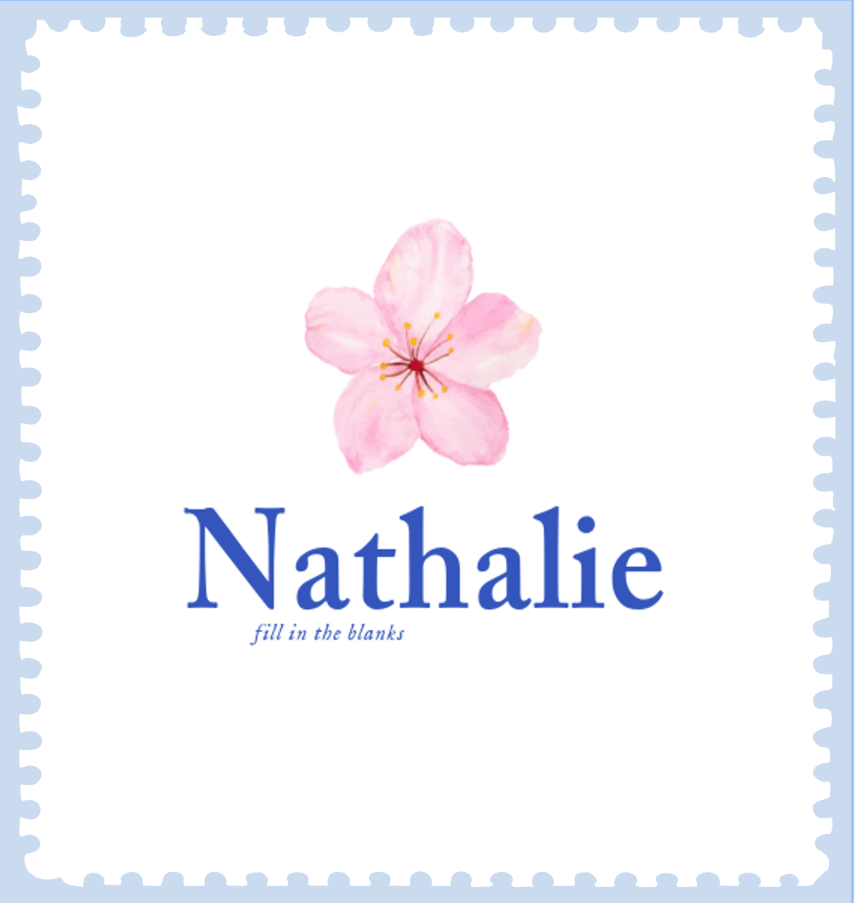
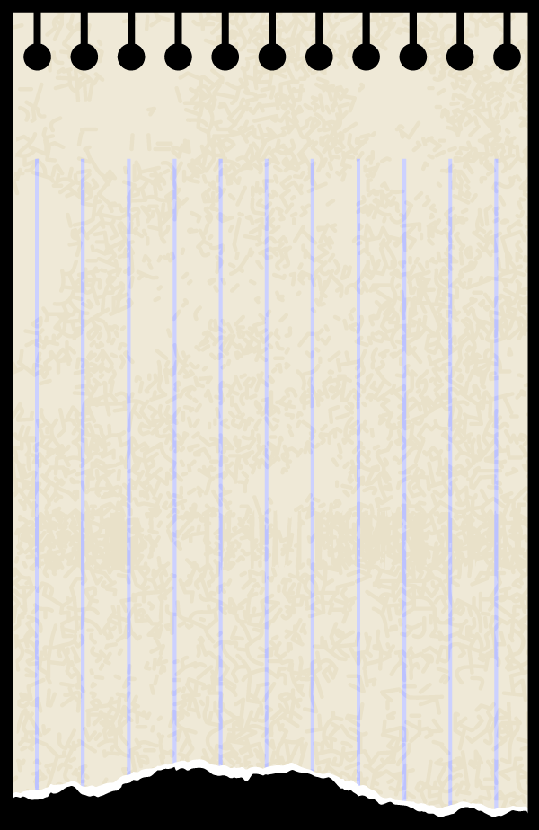
Nathalie’s Art
”To fill in the blanks”
Aisa, Shirine, Mayca, Bryan

Slide 2


Table of contents
01
02
03
Starting point
Research
Ideas
04
05
06
Branding
Strategy
Results

Slide 3
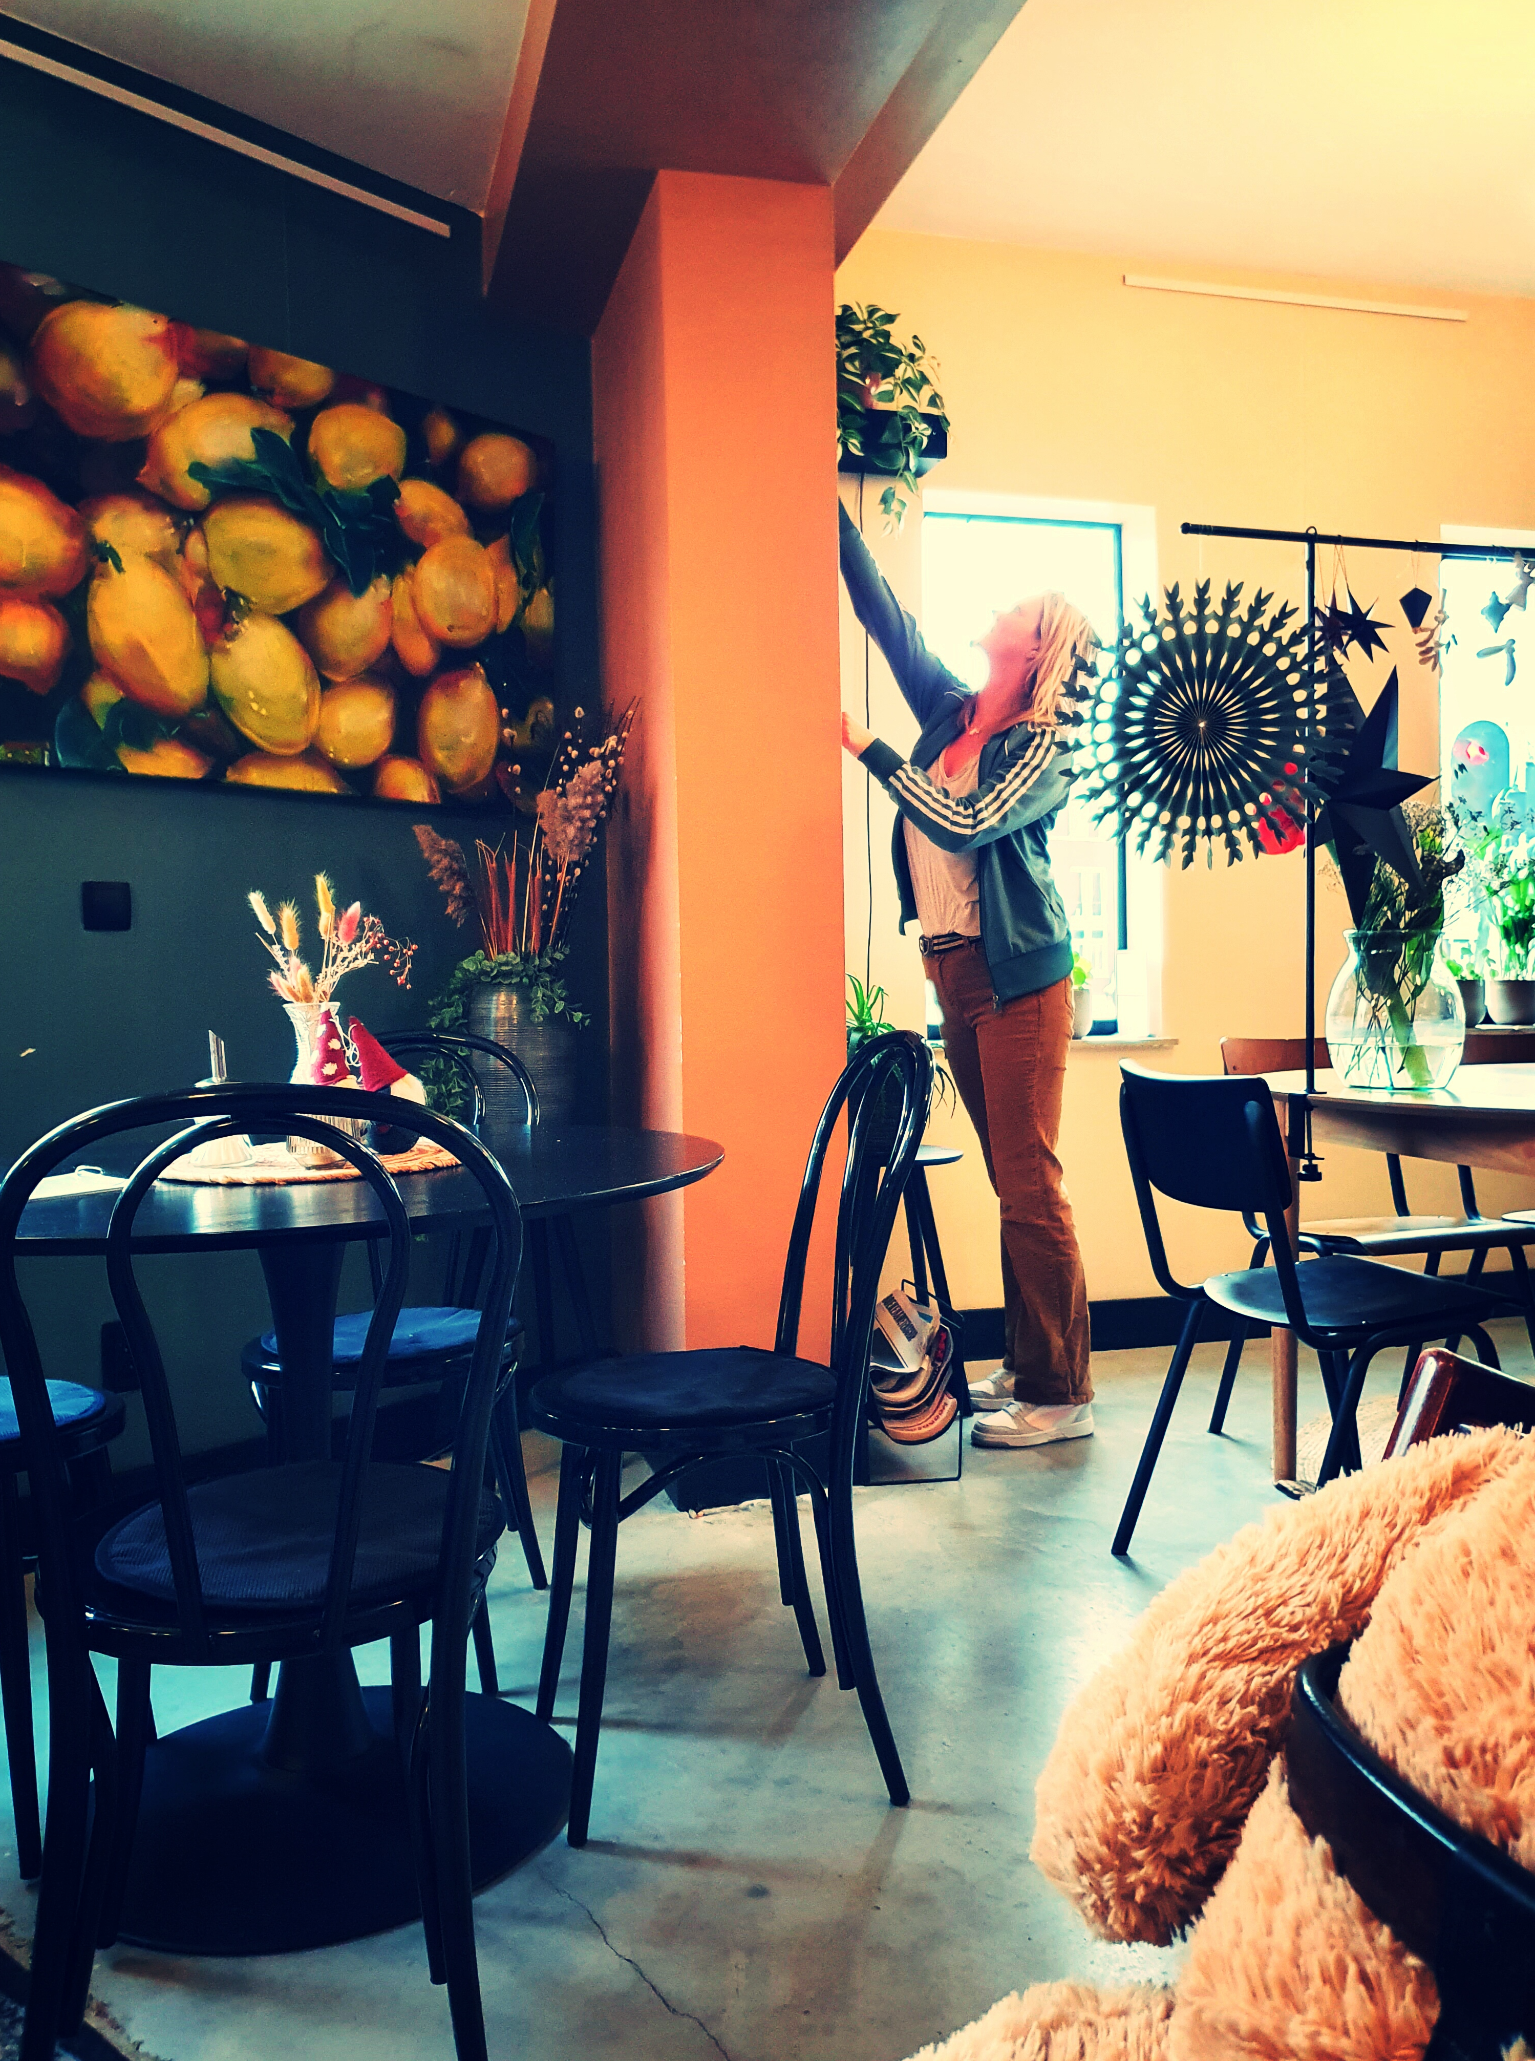
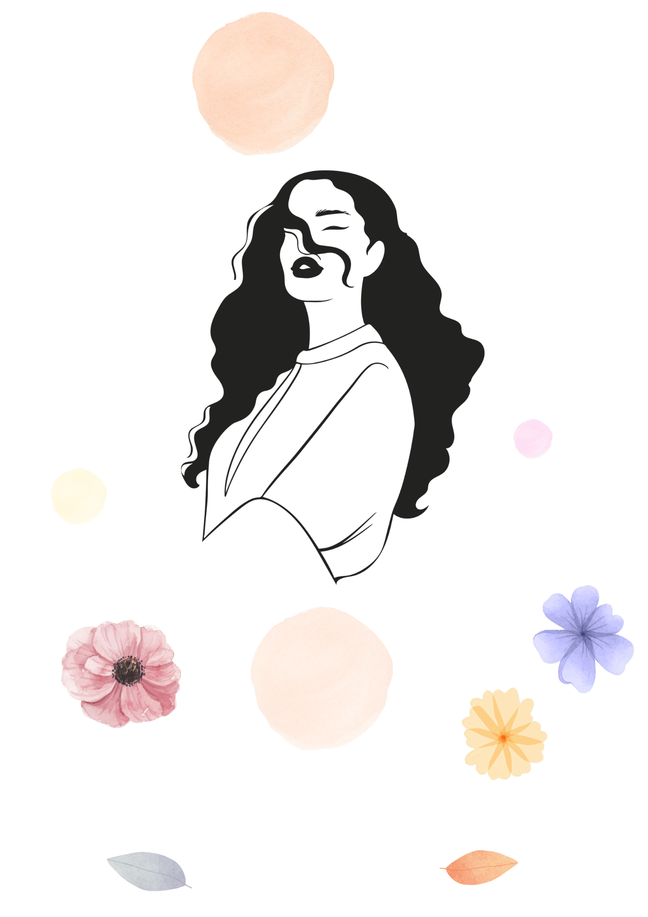
Where we started
An artist
The need for increasing brand awareness
Broad target
Notes:
At this point we weren’t sure who is our target, we just know we have a client with a few specific ideas, like pink colours, flowers, blooms, pastels, etc.
We started to brainstorm show the figma

Slide 4
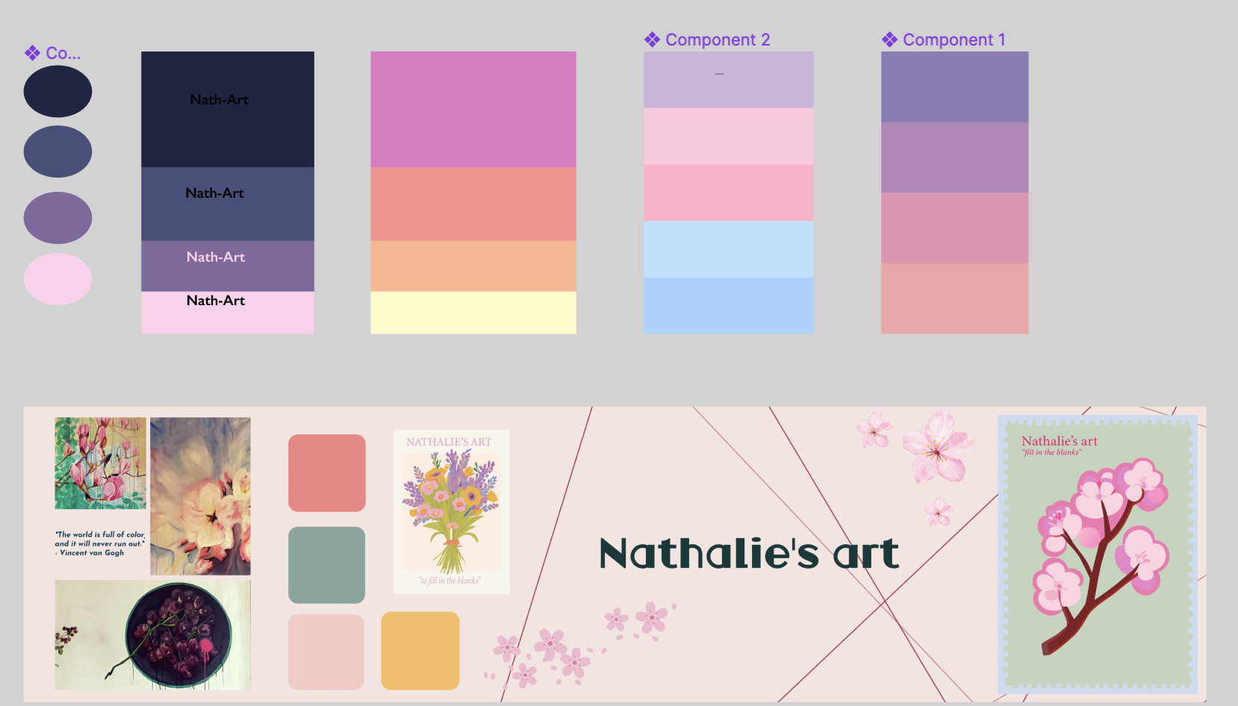
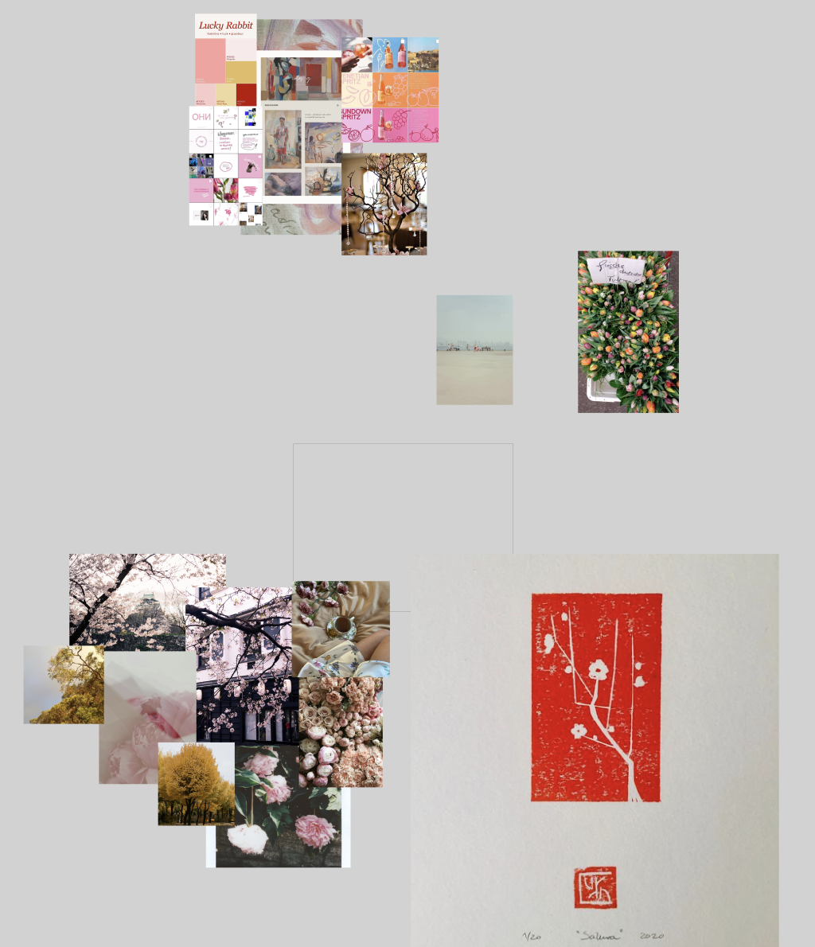
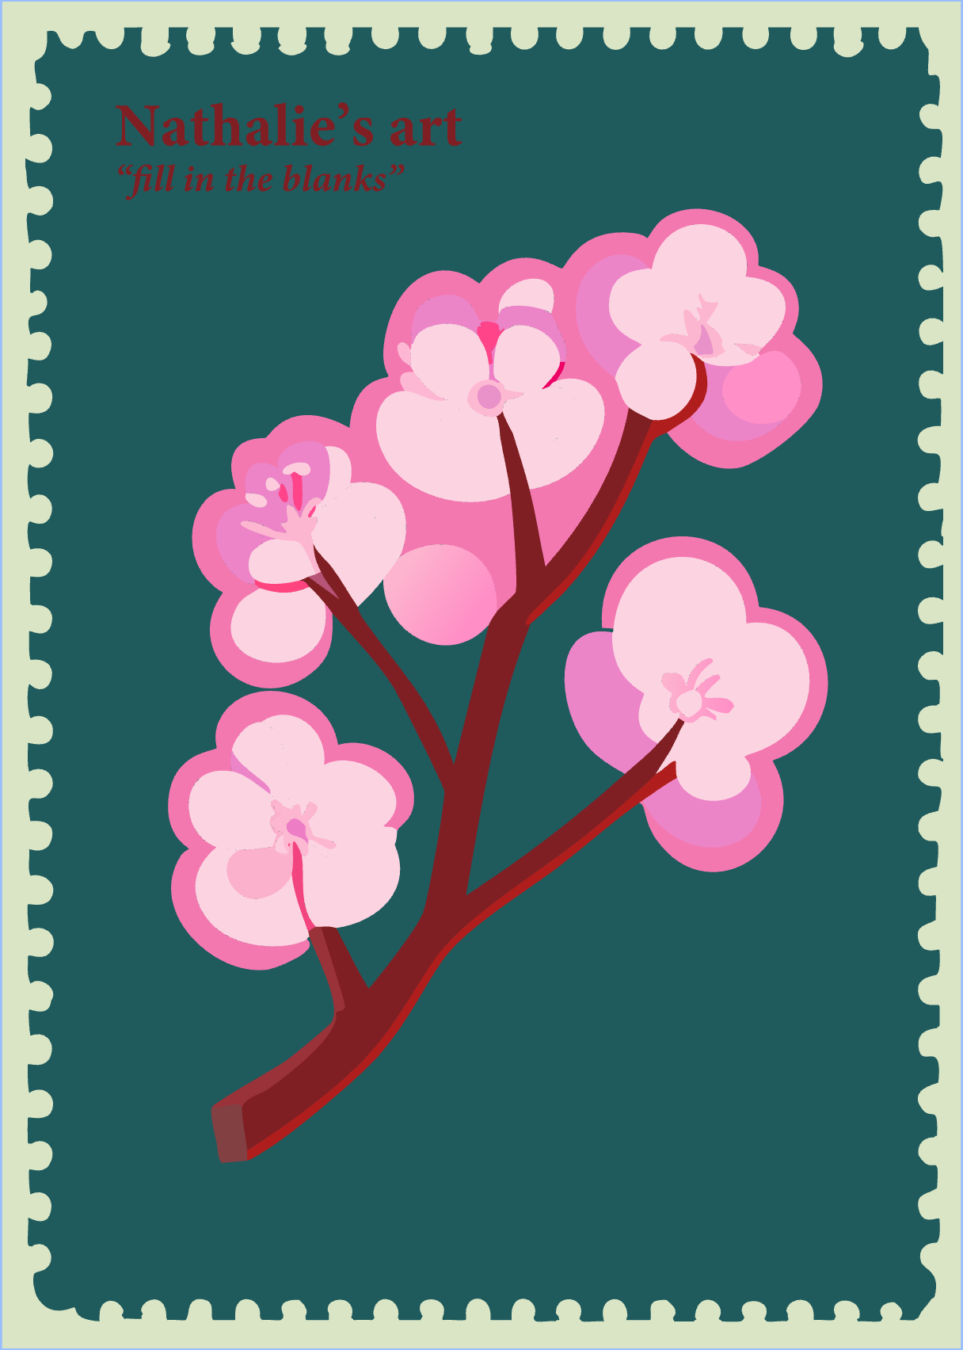
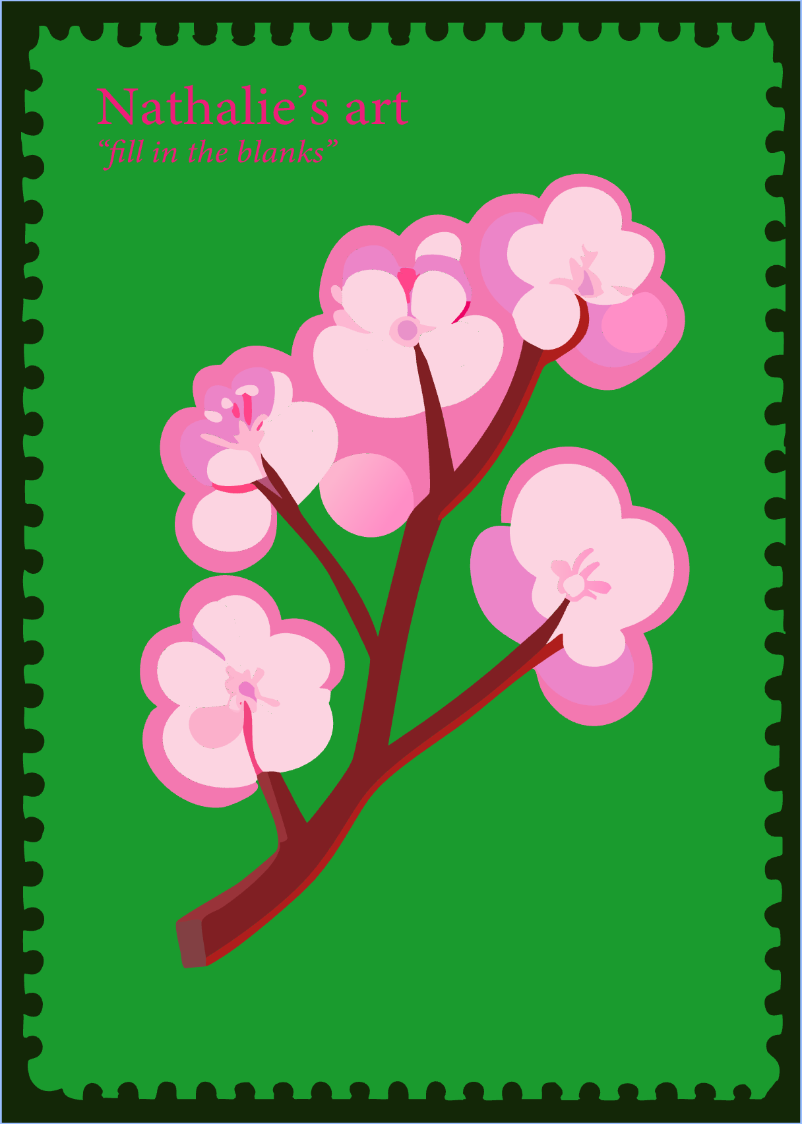
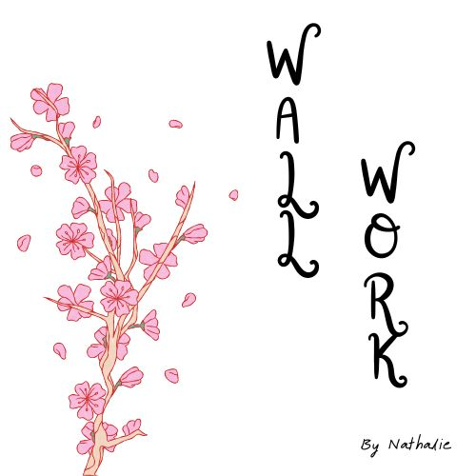
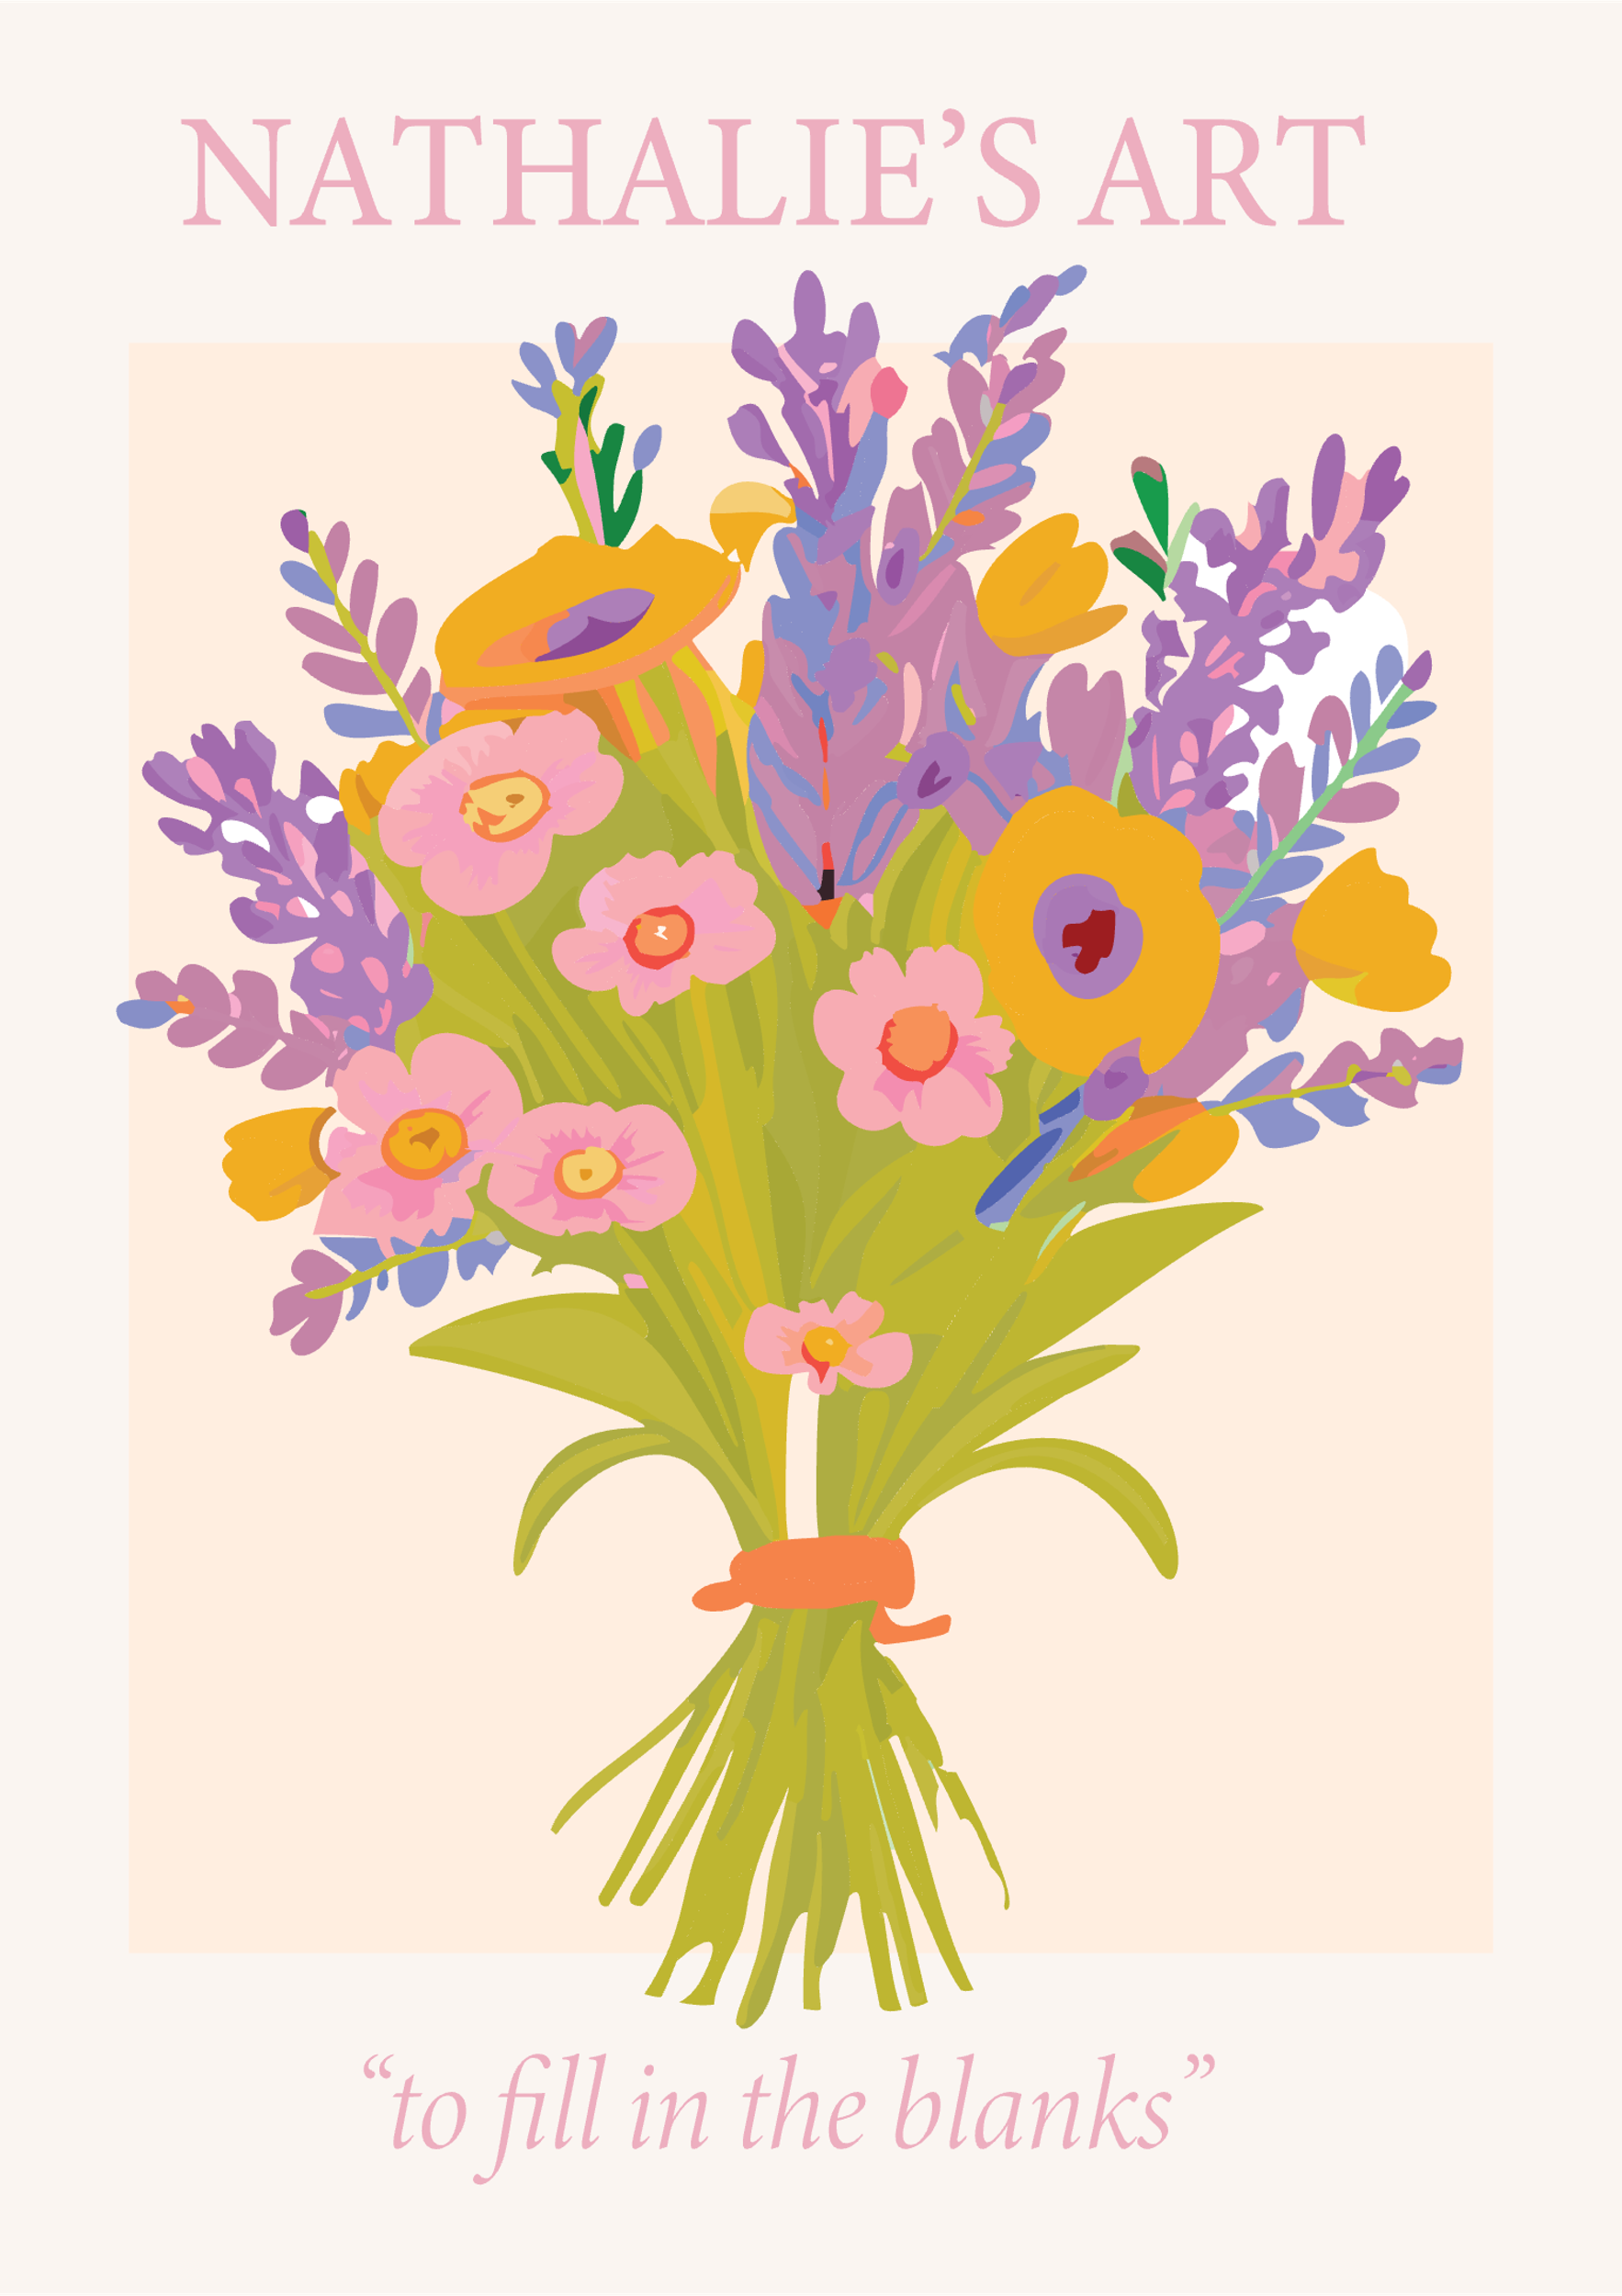
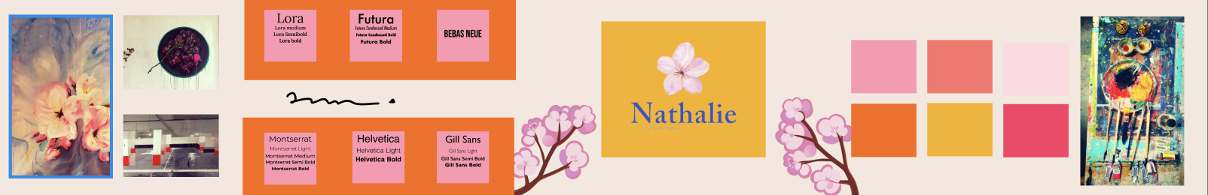

Slide 5
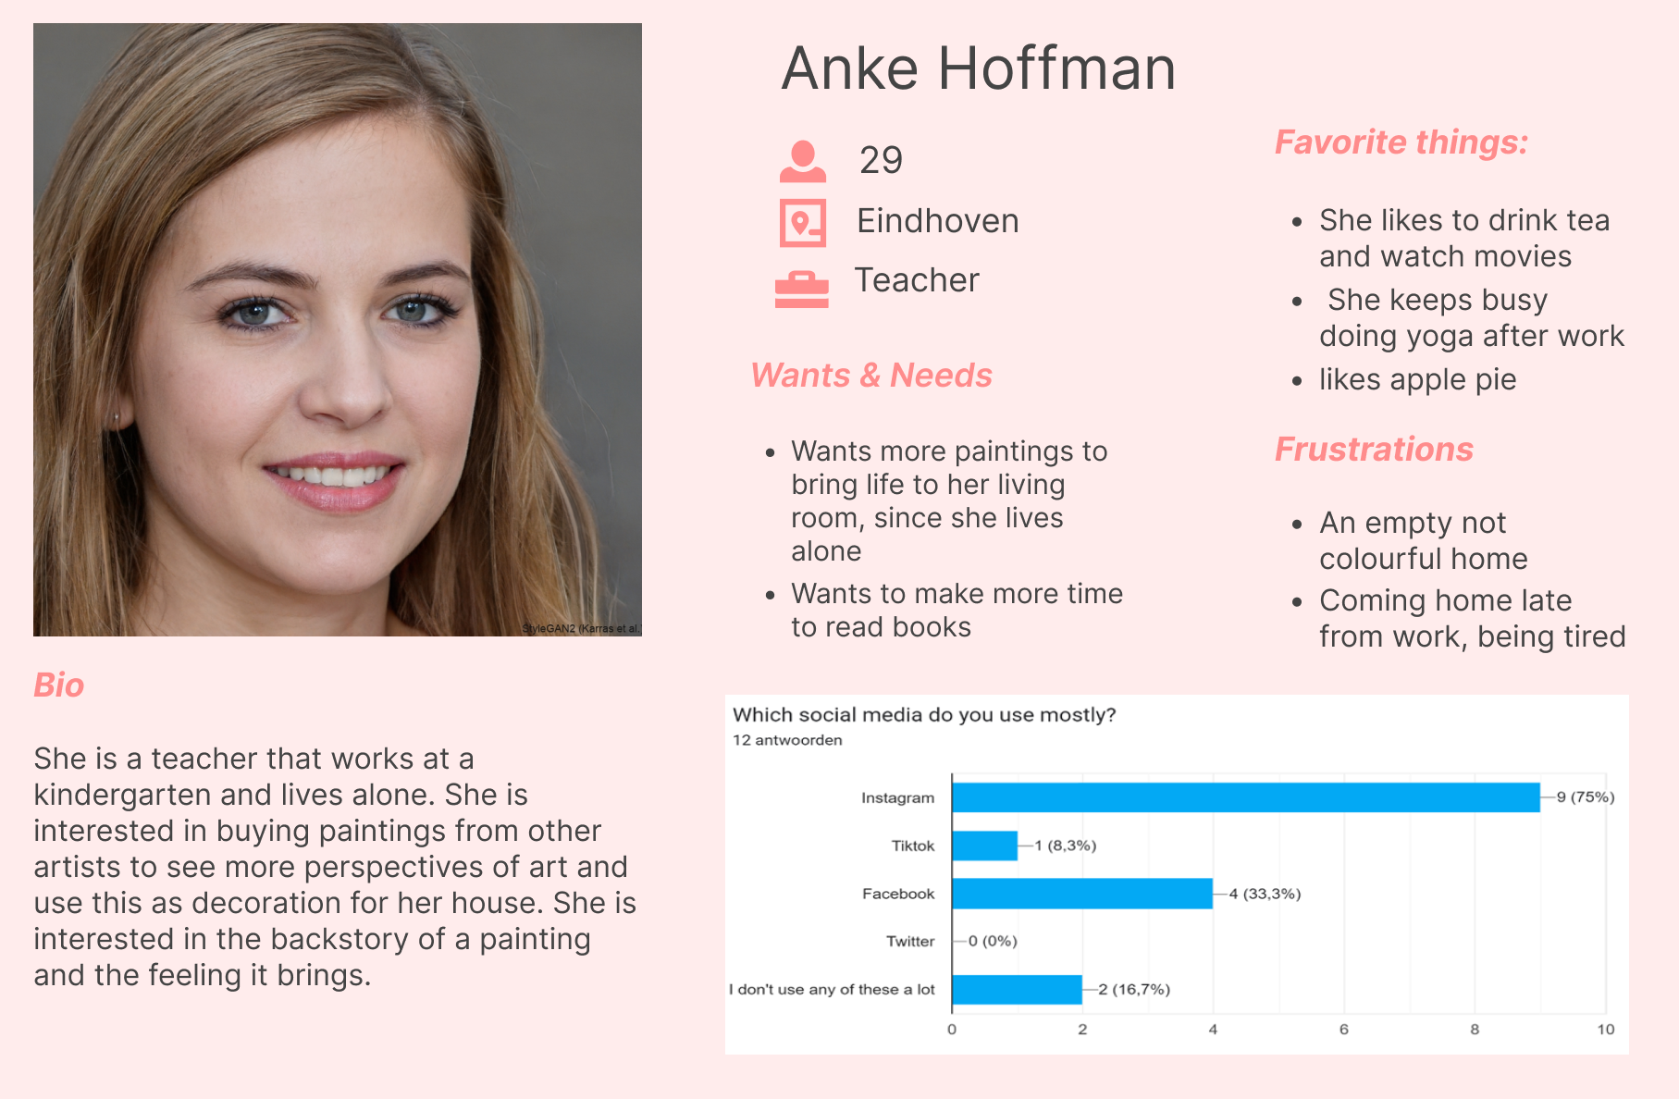
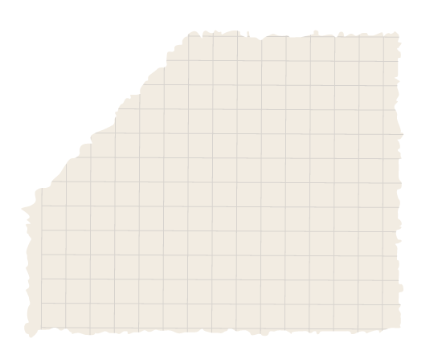
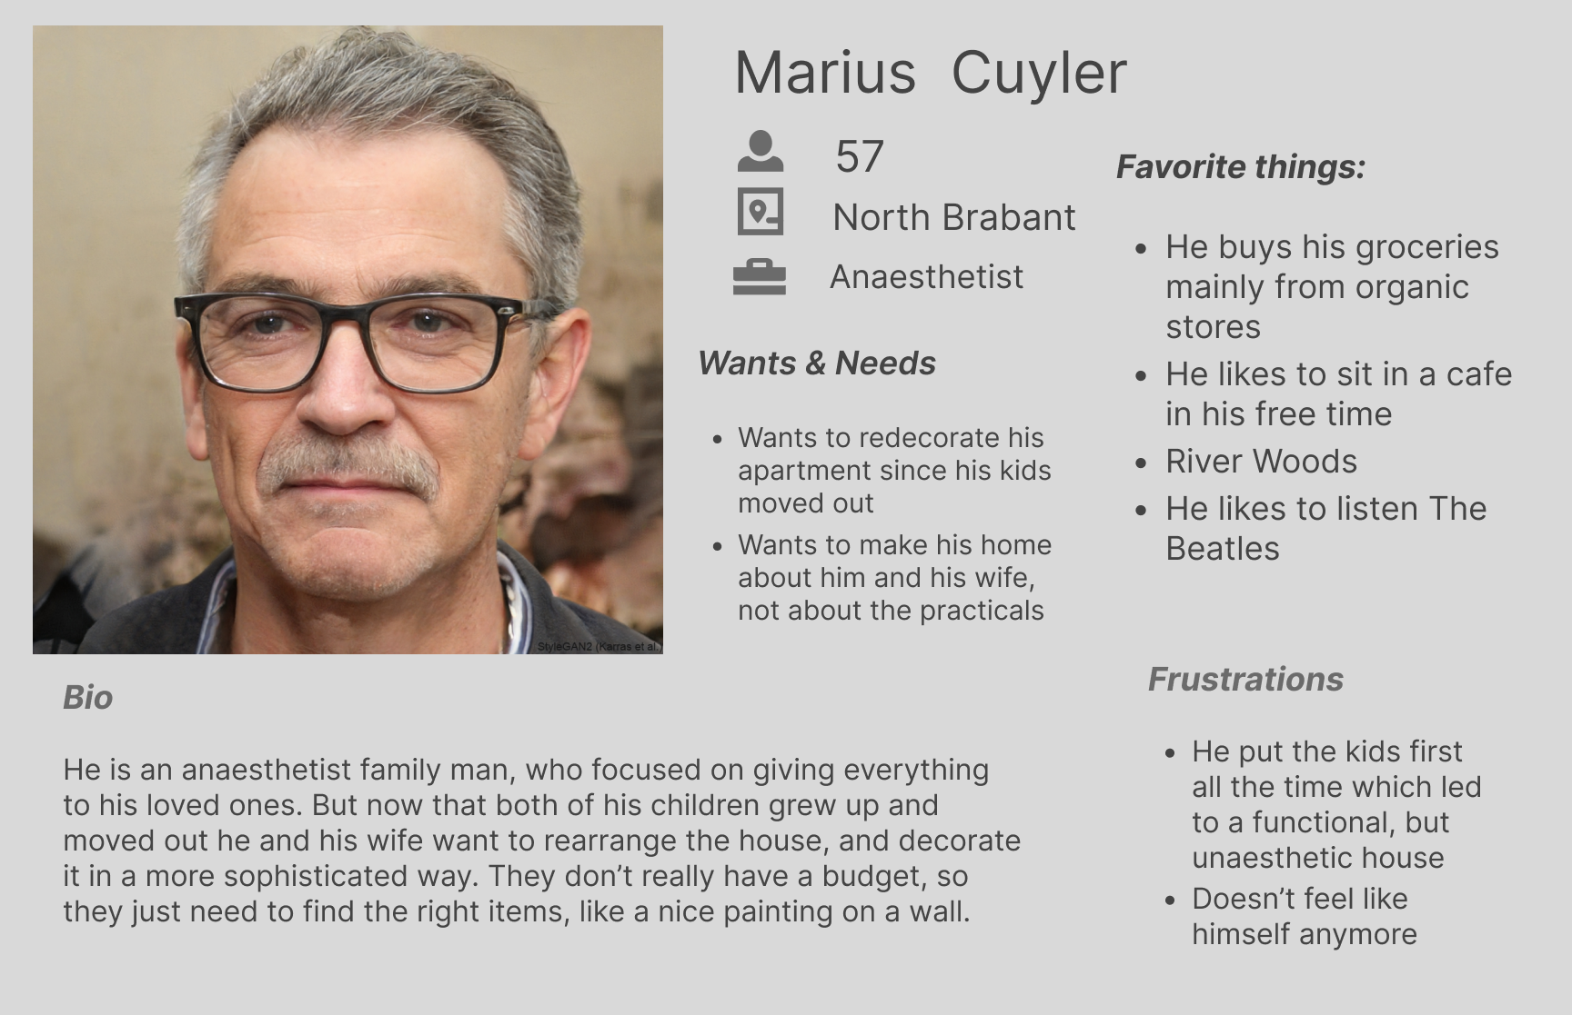
Research
Who is our target? What our client wants?
Interview with Nathalie
Conducting tests
Conclusion
Notes:
So we needed to start with a reasearch. We had an open Interview with Nathalie, who we could ask a few specific questions, so we learned more about her personality and style. But since we didn’t know anything about her target, our second step was to conduct interviews and make tests.
We wrote specific questions and went out to the field to look for the right people to ask.
We find out a lot about our target’s opinion. So we could make two personas.
Two bc,....

Slide 6
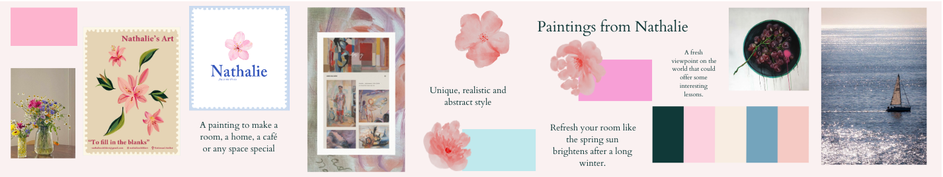
Ideas, Brand Guide

Slide 7
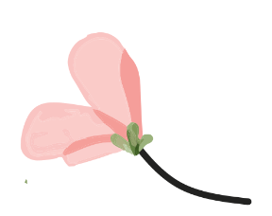
Strategy
Media Use
Planning

Slide 8
Results
https://www.figma.com/proto/luabxUhaHlKf9mXbd1JwGE/group-project-S2-n1?page-id=650%3A562&type=design&node-id=677-737&viewport=553%2C506%2C0.09&t=e2jl6cdthavicXf3-1&scaling=scale-down-width&starting-point-node-id=677%3A737&mode=design

Slide 9
Any questions?
Thanks for the attention!

